Slide 1
Software Analysis and Design (CS:3004)
Design Pattern
Singleton pattern

Slide 2
What is Design Pattern
Over the course of your career in software engineering, you will find that the same design problems reoccur. There are many ways to deal with these problems, but more flexible or reusable solutions are preferred in the industry. One of these preferred methods is that of design patterns.

Slide 3
What is Design Pattern
A design pattern is a practical proven solution to a recurring design problem. It allows you to use previously outlined solutions that expert developers have often used to solve a software problem, so you do not need to build a solution from the basics of object-oriented programming principles every time.
These solutions are not just theoretical – they are actual solutions used in the industry.
Design patterns may also be used to help fix tangled, structureless software code, also known as “spaghetti code.”

Slide 4

What is Design Pattern
A good way to think of design patterns is like recipes in a cookbook

Slide 5

What is Design Pattern
It is not always obvious which design pattern to use to solve a software design problem

Slide 6
What is Design Pattern
You can’t just find a pattern and copy it into your program, the way you can with off-the-shelf functions or libraries.
The pattern is not a specific piece of code, but a general concept for solving a particular problem.
You can follow the pattern details and implement a solution that suits the realities of your own program.

Slide 7
Design patterns
Design patterns are typical solutions to commonly occurring problems in software design. They are like pre-made blueprints that you can customize to solve a recurring design problem in your code.

Slide 8
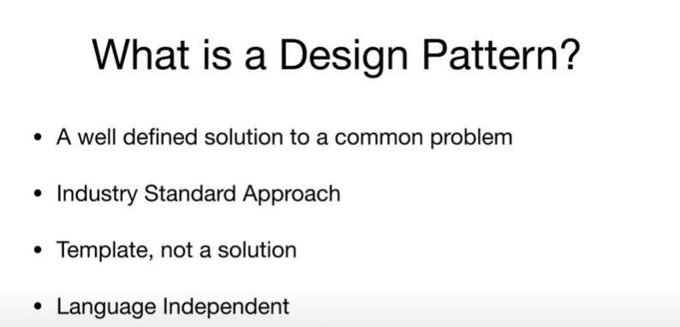

Slide 9
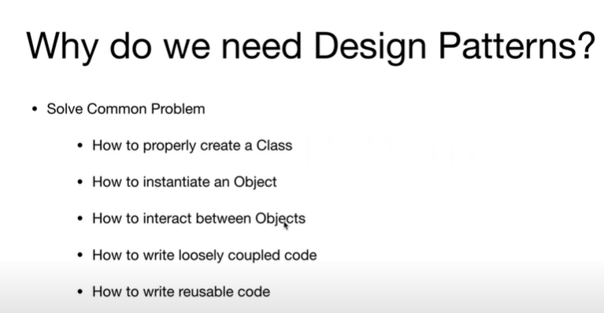

Slide 10
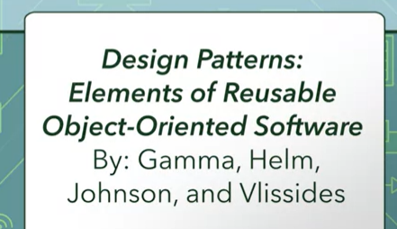
The Gang of Four
There are many design patterns you can find in books and via the Internet.
One of the most famous books on the topic is
Design Patterns: Elements of Reusable Object-Oriented Software.
This book was written by four authors who were given the nickname, The Gang of Four.
There are 23 patterns found in the Gang of Four's catalog

Slide 11




Introduction
Based on the principles of object-oriented programming: abstraction, inheritance, polymorphism and association.
Are solutions to recurring problems to software design.
Are independent of the application domain.
Example – Variability of interfaces – the modeller view controller (MVC) pattern.

Slide 12

The Downside
Although design patterns are useful in promoting flexibility, this maybe at the expense of a more complicated design.
There does not exist
A standardization for indexing patterns
General practices/processes for using design patterns during the design process have not as yet been established.

Slide 13

Object-Oriented Principles
Involves identifying:
Classes and objects
What to encapsulate
Association hierarchies
Inheritance hierarchies
Interface hierarchies
Object-oriented designs are evaluated in terms of how reusable, extensible and maintainable they are.

Slide 14
categories of patterns that the Gang of Four defined

Slide 15

Types of Pattern – Catalog 1
Creational patterns
Focus on Object creation.
Focus on the best way to create instances of objects to promote flexibility, e.g. factory pattern.
Structural patterns
Focus on Relationship between entities.
Focus on the composition of classes and objects into larger structures, e.g. the adapter pattern.
Behavioural patterns
Focus on Communication between objects
Focus on the interaction between classes or objects,
e.g. the observer pattern.

Slide 16

Types of Pattern – Catalog 2
Architectural patterns
Focus on the form of the overall system.
Design patterns
Focus on the form of the subsystems making up the overall system and essentially provides schemes for refining them.

Slide 17
What does the pattern consist of?
Most patterns are described very formally so people can reproduce them in many contexts. Here are the sections that are usually present in a pattern description:
Intent of the pattern briefly describes both the problem and the solution.
Motivation further explains the problem and the solution the pattern makes possible.
Structure of classes shows each part of the pattern and how they are related.
Code example in one of the popular programming languages makes it easier to grasp the idea behind the pattern.
Some pattern catalogs list other useful details, such as applicability of the pattern, implementation steps and relations with other patterns.

Slide 18
Singleton Pattern
Java Singleton Pattern is one of the Gangs of Four Design patterns and comes in the Creational Design Pattern category.
From the definition, it seems to be a very simple design pattern but when it comes to implementation, it comes with a lot of implementation concerns.

Slide 19


Singleton Pattern
Singleton is a creational design pattern that lets you ensure that a class has only one instance, while providing a global access point to this instance.

Slide 20
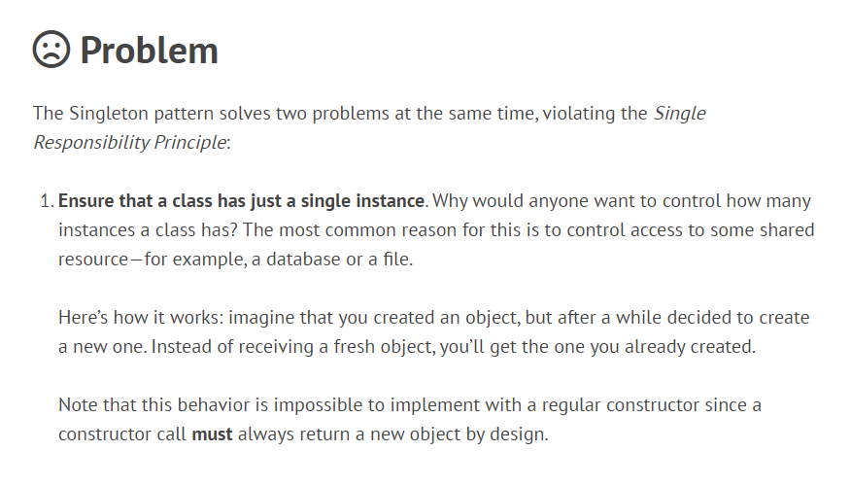

Slide 21
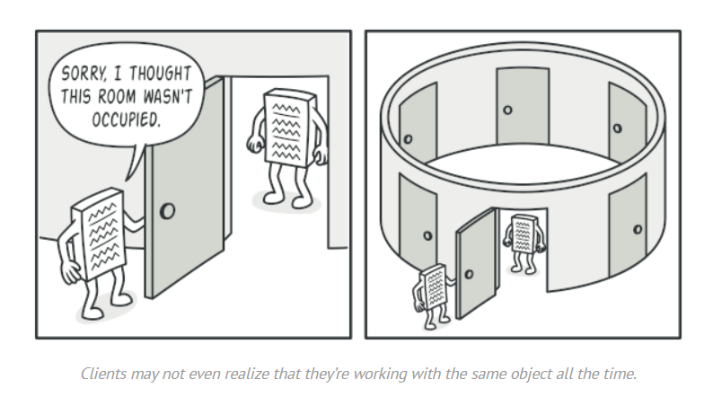
2. Provide a global access point to that instance.

Slide 22
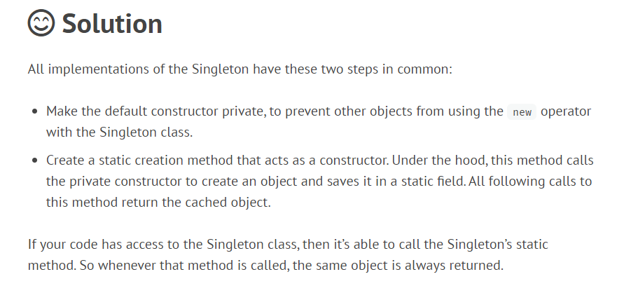

Slide 23
Java Singleton Pattern Implementation
To implement a Singleton pattern, we have different approaches but all of them have the following common concepts.
Private constructor to restrict instantiation of the class from other classes.
Private static variable of the same class that is the only instance of the class.
Public static method that returns the instance of the class, this is the global access point for outer world to get the instance of the singleton class.

Slide 24
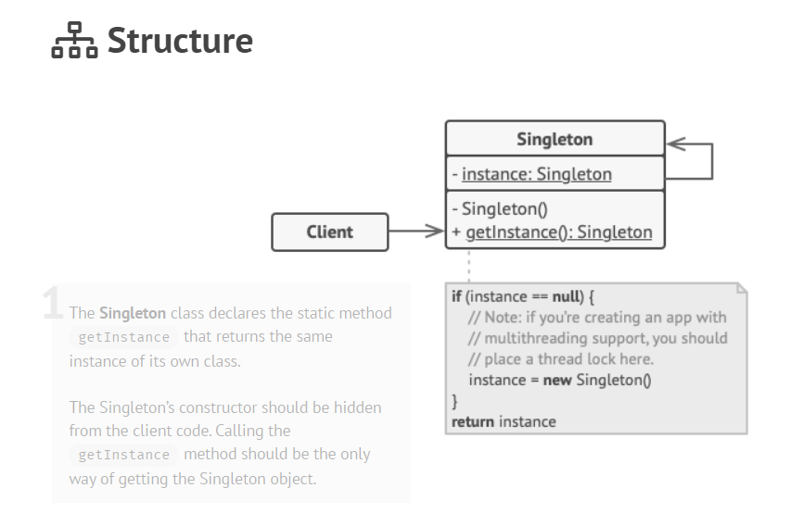

Slide 25
public class MySingletonClass{
private static MySingletonClass instance;
private MySingletonClass()
{
}
public static MySingletonClass CreateInstance()
{
if(instance == null)
{
instance = new MySingletonClass();
}
return instance;
}
}

Slide 26
class Demo {
public static void main(String args[]) //static method
{
MySingletonClass obj = MySingletonClass. CreateInstance();
}
}

Slide 27


